Slide 1
CSC3170
CUHK-Shenzhen Programming Contest Team

Slide 2
Content
SQL & Relational Algebra (DQL)
Storage-model
HashTables

Slide 3
SQL & Relational Algebra (DQL)
SELECT
PROJECTION
UNION
INTERSECTION
DIFFERENCE
PRODUCT
JOIN

Slide 4
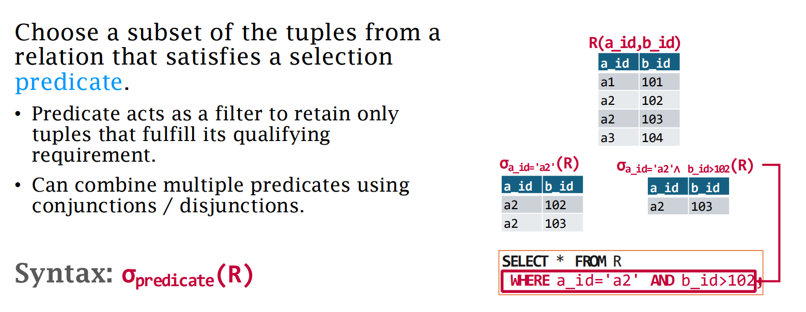
Relational Algebra: SELECT

Slide 5
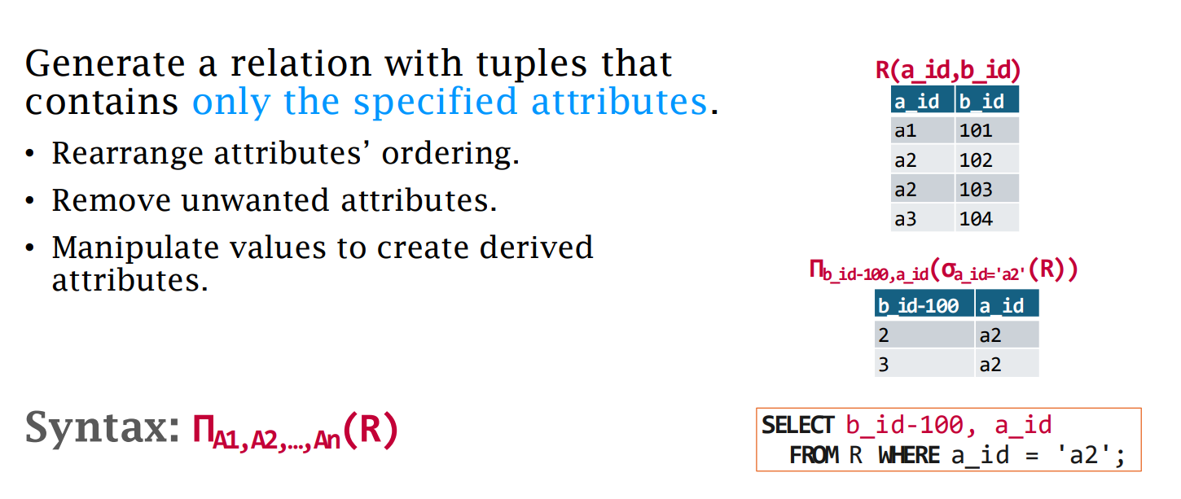
Relational Algebra: PROJECTION

Slide 6
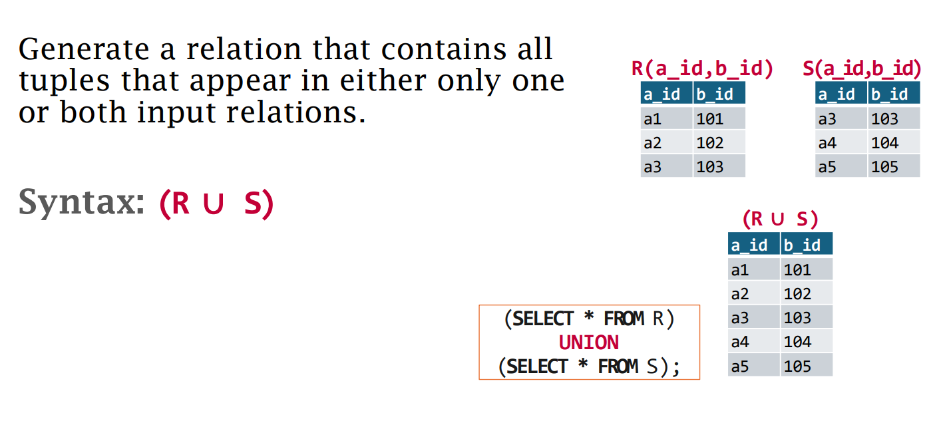
Relational Algebra: UNION

Slide 7
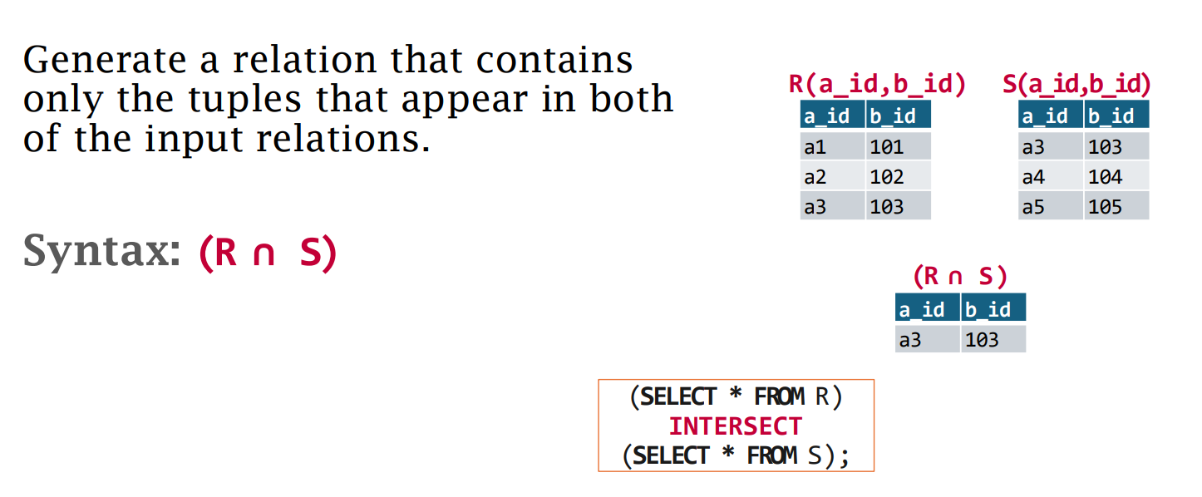
Relational Algebra: INTERSECTION

Slide 8
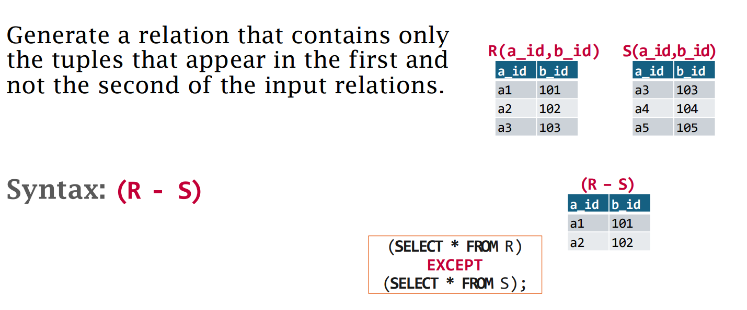
Relational Algebra: Difference

Slide 9
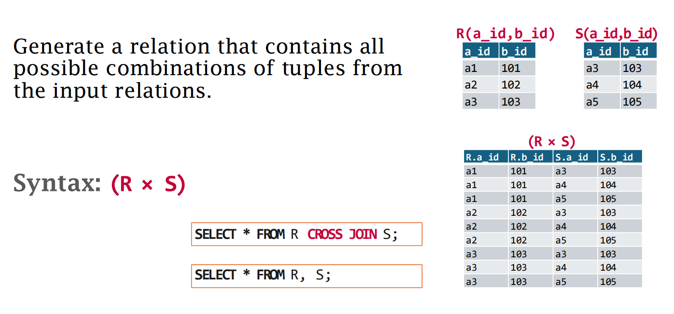
Relational Algebra: PRODUCT

Slide 10
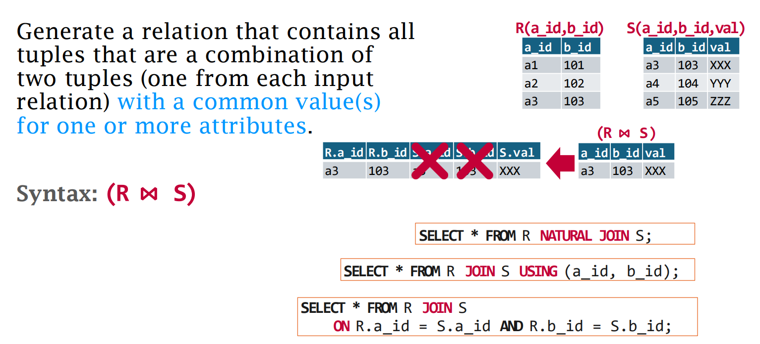
Relational Algebra: JOIN

Slide 11
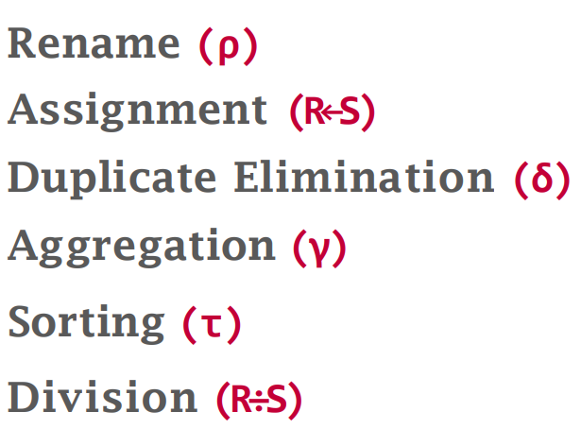
Relational Algebra: Additional

Slide 12
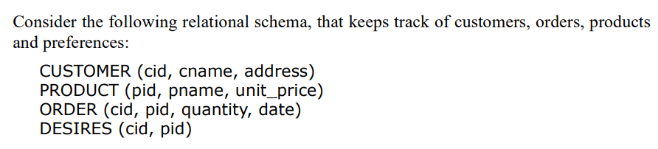
SQL: Practice
Read the following query SQL and state the result

Slide 13
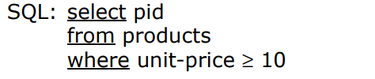
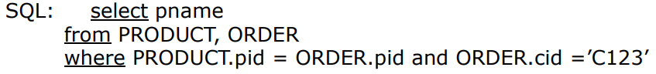
SQL: Practice
a:
b:
Notes:
a) RA 那里应该是大于等于10. b) RA 那里乱码的符号应该是nature join

Slide 14
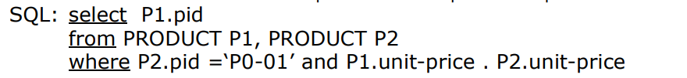
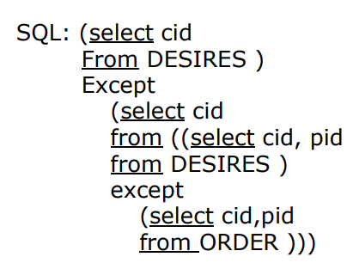
SQL: Practice
C:
D:
Notes:
C) SQL 中的’.’应该是＞

Slide 15
SQL: Answer

Slide 16
Storage
Page storage
Tuple storage

Slide 17
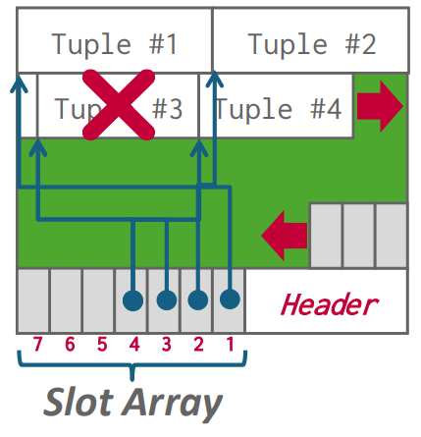
Page storage
Slotted page

Slide 18

Tuple storage
Tuple header
Word-alignment
padding
reordering

Slide 19
Word-alignment Recall
What’s the space difference between the following two schemas after padding?
Suppose INT takes 4B, BOOLEAN takes 1B and DATE takes 8B. Each word is 8B.
{height INT, student BOOLEAN, birthday DATE}
{height INT, birthday DATE, student BOOLEAN}

Slide 20
Storage-model
Online Transaction Processing (OLTP): Simple queries that read/update a small amount of data related to a single entity in the database.
Online Analytical Processing (OLAP): Complex queries that read large portions of the database spanning multiple entities.
NSM, DSM
Compression

Slide 21
Storage-model: compression (columnar)
Run-Length: Compress runs of the same value in a single column into triplets: (value, start position, length of runs).
Bit-Packing: Reduce the number of bits to represent each value.
Bitmap: Similar to One-hop coding, store a separate bitmap for each unique value for an attribute.
Delta: Recording the difference between values that follow each other in the same column.
Dictionary: Replace frequent values with smaller fixed-length codes and then maintain a mapping from the codes to the original values.

Slide 22
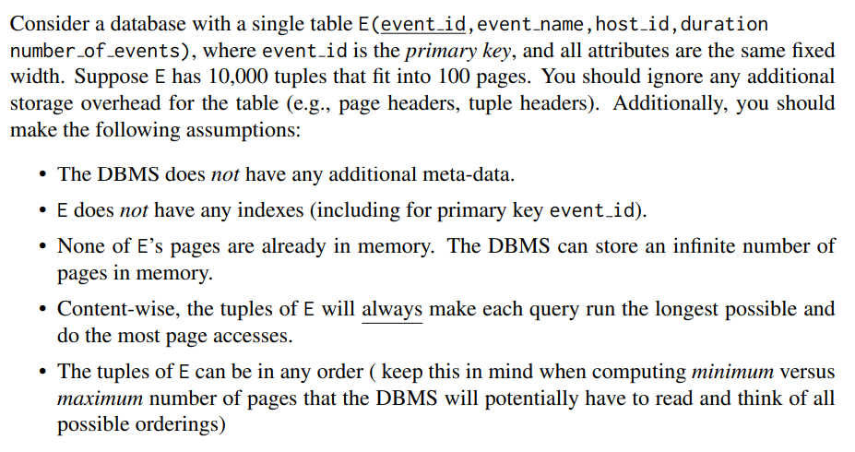
Storage-model: Practice

Slide 23
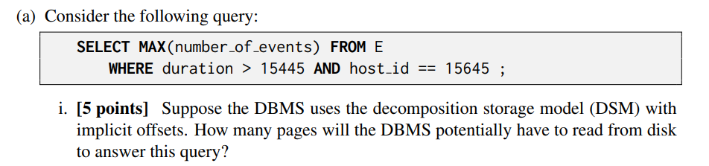

Storage-model: Practice
i. 60, ii. 100

Slide 24
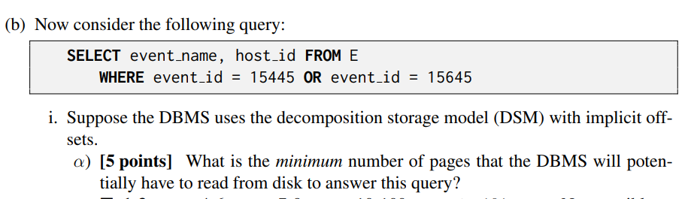

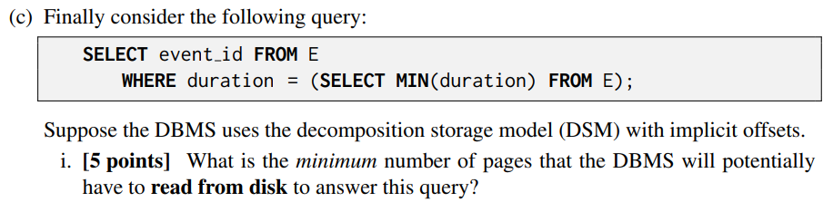
Storage-model: Practice
(b) i. 3, 24 ii. 1, 100
(c) i. 40

Slide 25
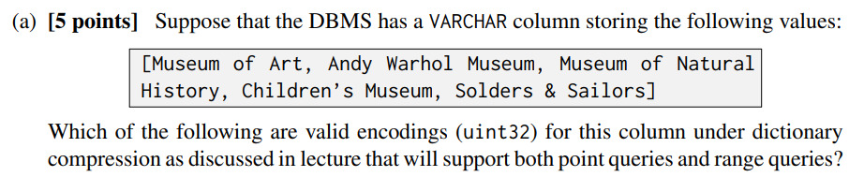
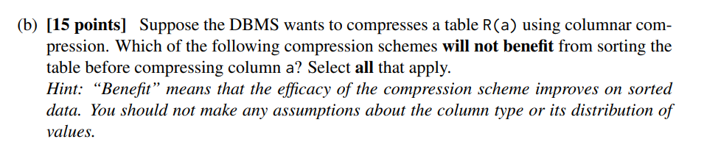
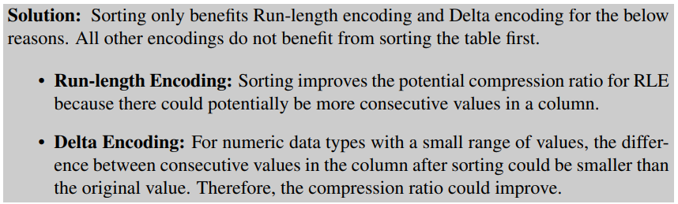
Compression: Practice
[3,1,4,2,5]

Slide 26
HashTables
Static hash
Linear Probe Hashing
Cuckoo Hashing
Dynamic hash
Chained Hashing
Extendible Hashing
Linear Hashing

Slide 27
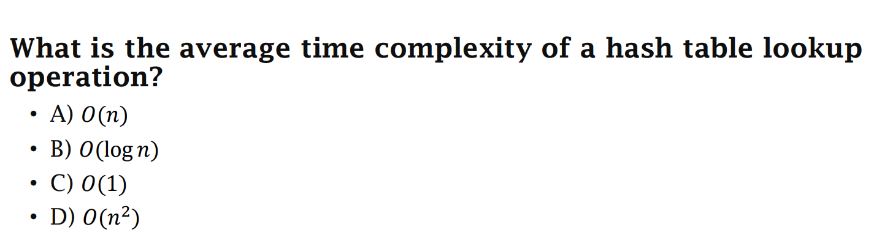
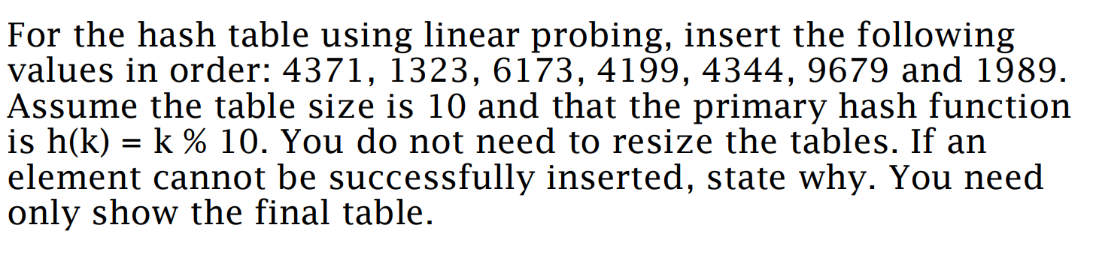
HashTables: Practice
C
9679
4371
1989
1323
6173
4344
x
x
x
4199

